Slide 1
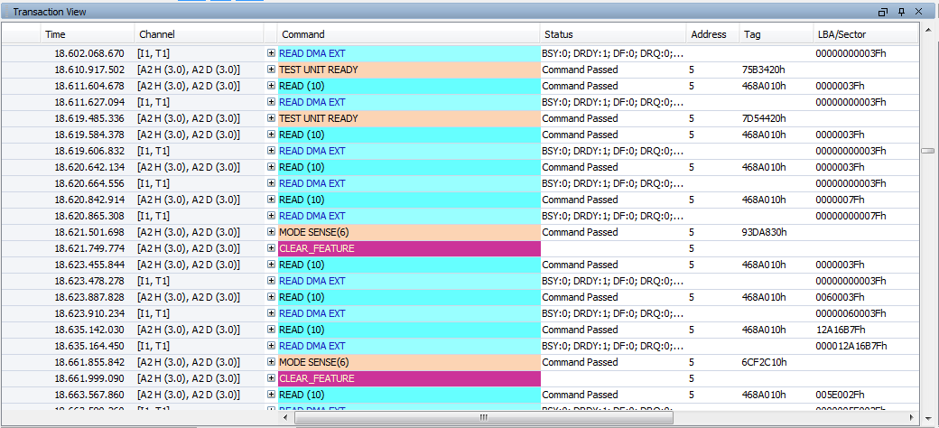
Cascaded USB and SATA/SAS
SATA traffics
USB traffics
The only solution to offer SAS/SATA and USB in the same trace,
time correlated and completely synched
Notes:
‘Cascadable with SAS/SATA’ is a unique feature for Agilent, this is the powerful analysis capability when your customer is dealing with SAS/SATA and USB interchange.
This screen shot will help you to understand more how the software can handle 2 different traffics in a single screen.
The most important thing is both traffics are actually captured at the same timestamp.
This will help your customer to analyze the time taken and what is happening for the input and output.
For example you have a harddisk where equipped with SATA traffic, but your connection is USB. So, your device needs to have a chipset to convert USB to SATA or vice versa.
Therefore, you need to know how much time for the traffic exchange as well as make sure the input and output data is correct.

Slide 2
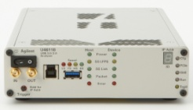
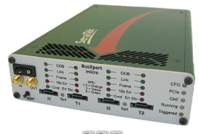
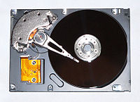
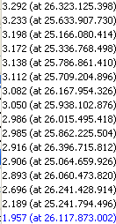

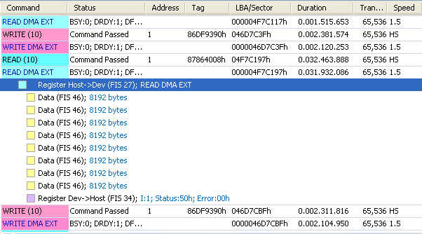
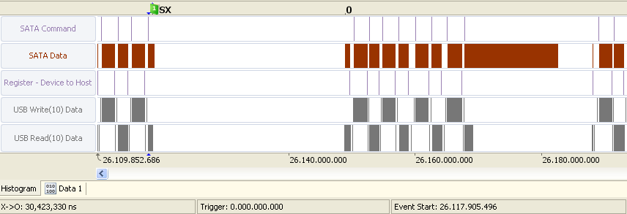
USB protocol analyzer
SATA protocol analyzer
USB ←→ SATA Simultaneous Debug Example
HDD
Host PC
USB⇔SATA media convert cable
From the statistical data, you will find ReadDMA throughput slowed down as low as 2MB/s in some duration of time. The average is 33MB/s.
Click on 1.957MB/s on the statistics window, select it from the listing that came up, and jump to the location within the trace data (captured data).
You will quickly find that it took 32ms for the READ of 04F7C197 right after WRITE of LBA046D7C3F. Not only SATA, you can see USB took 32ms as well.
By observing the histogram, you can quickly see there was a “hold” during the READ to LBA04F7C197.
By setting O and X cursors between holds, you can visually see the hold was about 30ms as well.
U4611A + U3051B are the only combination which allow you to give this much insights into both SATA and USB buses simultaneously.
1) The Read DMA throughput has decreased to less than 2MB/sec from an average 33MB/sec
2) Click 1.957μsec, select from the list, the hyperlink to the tracedata
3) USB also have taken not only 32msec. SATA and found that it took about 32msec to Read After Write of 04F7C197 LBA046D7C3F.
4) The Hold that was in the middle of a Read to LBA04F7C197 is seen in the histogram.
30msec
5) The Hold time of 30msec is measured by setting the X and O cursors.

Slide 3
USB protocol analyzer
SATA protocol analyzer
HDD
Host PC
USB⇔SATA media convert cable
1) The Read DMA throughput has decreased to less than 2MB/sec from an average 33MB/sec
2) Click 1.957μsec, select from the list, the hyperlink to the tracedata
3) USB also have taken not only 32msec. SATA and found that it took about 32msec to Read After Write of 04F7C197 LBA046D7C3F.
4) The Hold that was in the middle of a Read to LBA04F7C197 is seen in the histogram.
30msec
5) The Hold time of 30msec is measured by setting the X and O cursors.

